Slide 1
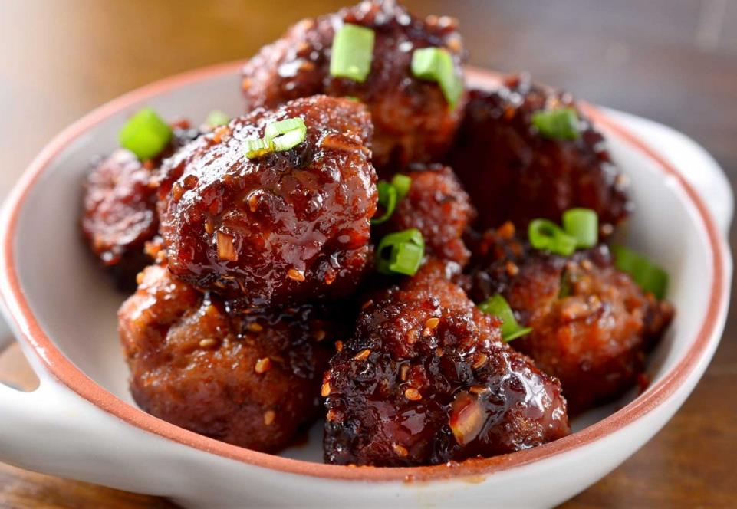

MENU ADOPTION CYCLES
turkey MAC | meat MAC update
MAY 2017
Contact Datassential: 312.219.6431 | kristy.pfaffinger@datassential.com
National Turkey Federation

Slide 2
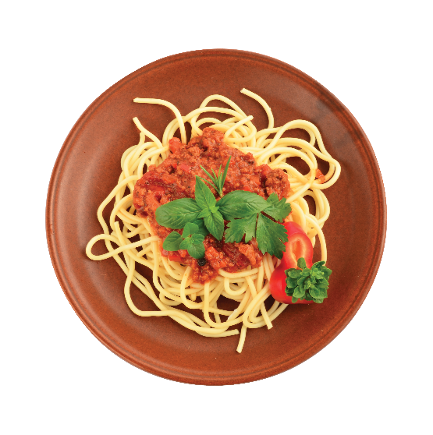
MENU ADOPTION CYCLE (MAC)
Food trends follow a predictable life cycle.
The MAC helps you determine a trend’s current life stage, as well as its potential for future advancement.
2. ADOPTION
3. PROLIFERATION
Adoption-stage trends grow their base via lower price points and simpler prep methods. Still differentiated, these trends often feature premium and/or generally authentic ingredients.
Proliferation-stage trends are adjusted for mainstream appeal. Often combined with popular applications (on a burger, pasta, etc.),
IN FOODSERVICE:
IN FOODSERVICE:
Casual chain restaurants
Quick service restaurants
Fast-casual restaurants Casual independents
AT RETAIL:
AT RETAIL:
Traditional supermarkets
Mass merchandisers
Specialty grocery stores Gourmet food stores
1. INCEPTION
4. UBIQUITY
Ubiquity-stage trends have reached maturity, and can be found across all sectors of the food industry. Though often diluted by this point, their inception-stage roots are still recognizable.
Trends start here. Inception-stage trends exemplify originality in flavor, preparation, and presentation.
IN FOODSERVICE:
AT RETAIL:
IN FOODSERVICE:
AT RETAIL:
Fine dining
Ethnic independents
Ethnic markets
Family restaurants School cafeterias
Dollar stores Drug stores

Slide 3



Turkey
| Menu Adoption Cycle
Sloppy Joe
Cuban Sandwich
Open Faced Sandwich
Turkey Ham
Breakfast Burrito
Smoked Turkey
Slider
Pita
Ground Turkey
Burrito
Turkey Bacon
Chef Salad
Wrap
Turkey Wing
Cobb
Fried Turkey
Taco
Bowl
Turkey Chili
Turkey Sub
Turkey Soup
Salad
Melt
Turkey Hash
Stew
Turkey Sausage
Turkey Meatball
Turkey Burger
Panini
Turkey Risotto
Turkey And Stuffing
Blackened Turkey
Turkey Pastrami
Turkey Hot Dog
Sandwich
Monte Cristo
Omelette
Rotisserie Turkey
Turkey Club / Blt
Olive oil cake
Cajun Turkey
olive oil cake
Turkey Breast
Empanada
Turkey Pot Pie
Turkey Bolognese
Breakfast Sandwich
Bbq Turkey
Roasted Turkey
Hot Brown
Turkey Tetrazzini
Dumpling
Crepe
Skewer
Turkey Reuben
Drumstick
Tagine
Croquette
Peppered Turkey
Frittata
Turkey Gravy
Turkey Tips
Confite
Turducken
Maple Turkey
Turkey Meatloaf
Turkey Benedict
Pate
Pulled Turkey
Thigh
Hickory Smoked
Arepa
Pozole
Turkey Tenderloin
inception
adoption
proliferation
ubiquity

Slide 4
Meats
| Menu Adoption Cycle
Applewood Smoked Bacon
Carnita
Pulled Pork
Ham
Ribeye Steak
Andouille
Strip Steak
Meatloaf
Roast Beef
Capicola
Brisket
Chuck
Boar
Bone Marrow
Carpaccio
Prime Rib
Sausage
Rib
Candied Bacon
Charcuterie
Top Sirloin
T-Bone Steak
Chicharron
Lardon
Bresaola
Flank Steak
Shredded Beef
Sirloin
Salami
Linguica
Merguez
Bison
Hanger Steak
New York Strip
Pork Chop
Meatball
Porchetta
Tongue
Kobe
Mortadella
Flat Iron Steak
Pepperoni
Chorizo
Goat
Sweetbreads
Porterhouse Steak
Filet Mignon
Ground Beef
Bacon
Olive oil cake
olive oil cake
Venison
Chicken
Veal Cheek
Pork Belly
Beef Tenderloin
Angus
Rabbit
Animal Heart
Tartare
Turkey Sausage
Turkey
Wagyu
Pork Rind
Short Rib
Veal
Turkey Bacon
Roasted Turkey
Coppa
Pig Ear
Sopressata
Ground Turkey
Pig Tail
Alligator
Prosciutto
Bratwurst
Skirt Steak
Elk
Pork Shoulder
Lamb
Tri Tip Steak
Pork Butt
Tasso
Pancetta
Duck
inception
adoption
proliferation
ubiquity

